Slide 1
P1 Digit Recognition
Name: 赵子涵 Major: Computer Science
Student ID: 2023E8013282148

Slide 2
Dataset
The MNIST consist 60000 28*28 grayscale images for train set, and 10000 for test set. The images are all handwritten digits, and lable ranges from 0 to 9.

Slide 3
Model Design
We implemented a CNN for this task. Specifically, the CNN we build consist three basic components, the convolution layer, the poolling layer, and the linear layer. A diagram of our network with hyper-parameters is presented on the next page.

Slide 5
Model Design
Moreover, we choose Maxpool as our pooling layer, and ReLU as our activation function.

Slide 6
Model Evaluation
We trained our model with batch_size=100, learning_rate=0.001 and epoch=5. We plot the loss and test accuracy as follows.

Slide 7
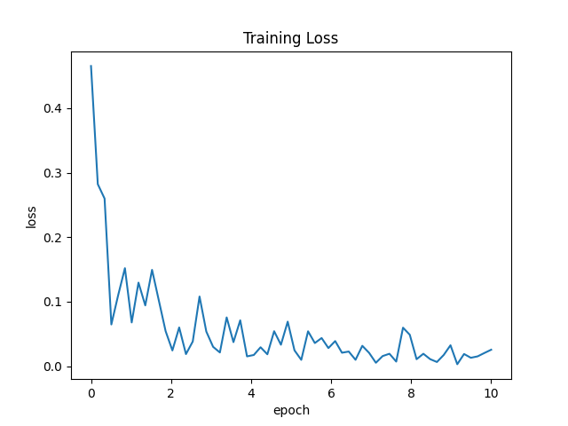
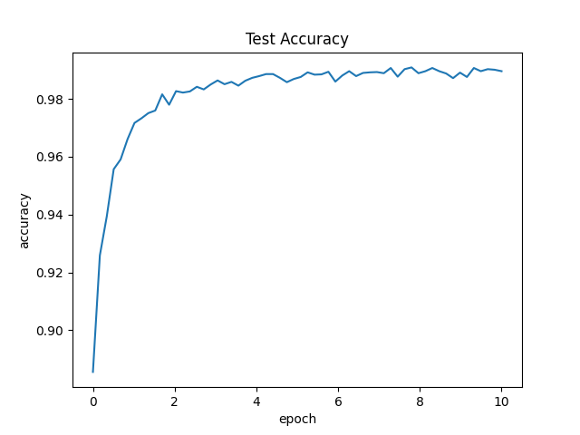

Slide 8
Model Evaluation
As shown above, the training loss decline rapidly, and the test accuracy reached 99%.

